Slide 1
HACKATHON 3
TWITTER FEEDS – SENTIMENT ANALYSIS
TEAM SENTI MEN
Girish, Ramesh and Sunit

Slide 2
Problem Statement
We have been given evaluated tweets about multiple brands
The evaluators were asked if the tweet expressed positive, negative, or no emotion towards a product/brand and labelled accordingly
Identifying the sentiments about the product/brand in the tweet can help decision making

Slide 3
Potential Business Problems and Benefits of Solving
There are multiple competing products mentioned in these campaigns
Tweets express sentiments both about the brands in isolation and in the context of events
This data is very valuable to:
A) Gauge the effectiveness of a campaign or promotion for a brand
B) Gauge the market sentiment in favor of or against a brand at a point in time
C) Plan user engagement initiatives based on the findings
D) Identify traits of “influencers” and design marketing strategies accordingly

Slide 4
Initial Data
The raw data presented 7273 tweets with associated sentiments
Sentiment | Meaning | Count
0 | Negative | 456
1 | Neutral | 4310
2 | Positive | 2382
3 | Can’t tell | 125

Slide 5
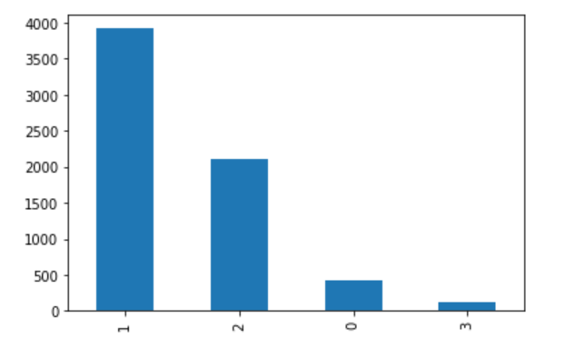
Preprocessing Steps
Visualizing the data
Largely neutral followed by ~2000 positives and 400 negatives

Slide 6
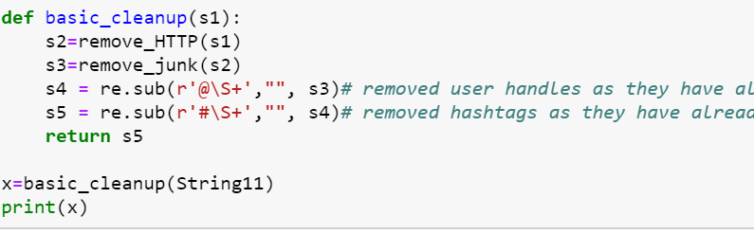
Preprocessing Steps 2
Removed 1 null record
Cleaning up junk characters
Extracting user names [@username]
Extracting hashtags and storing them for analysis
Removing URLs [ http://anyurl.com ] as they are just noise

Slide 7
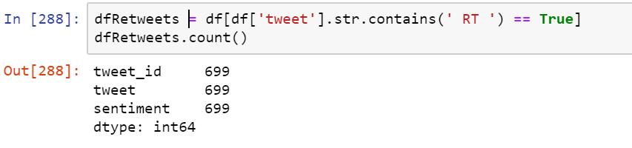
Exploratory Data Analysis steps
Checking the number of Re-tweets
Choice whether to keep or remove [ < 10% ]
Checked emoticons and classified them

Slide 8
Exploratory Data Analysis insights
Identifying
Capitalized words
Nouns
Noun phrases
Stop words [ for removal ]
Word tokenizing
Lemmatizing
Getting tweet length and checking if there is a correlation

Slide 9
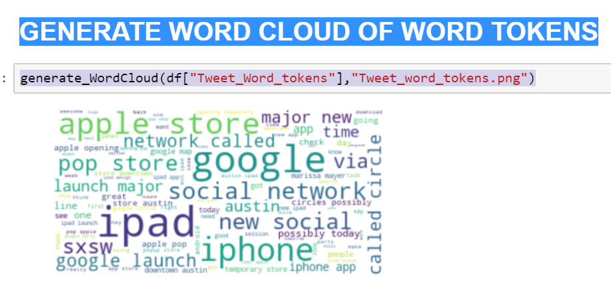
Exploratory Data Analysis insights 3
Word clouds of word tokens – most common words

Slide 10
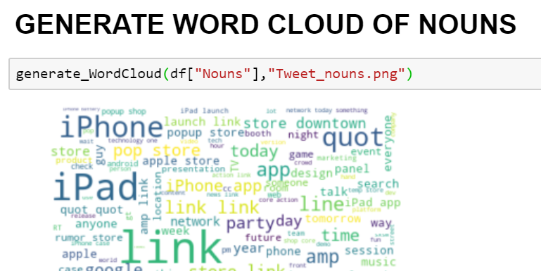
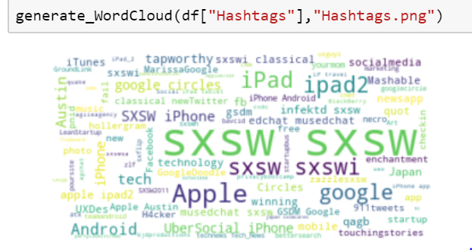
Exploratory Data Analysis insights 3
Word clouds of nouns –
Apple, Google, iPad, Android, iPhone most popular

Slide 11
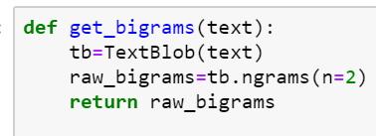
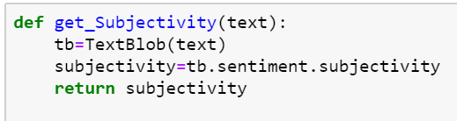
Exploratory Data Analysis insights 4
Generated Bi-grams and Tri-grams
Generated and checked Polarity and Subjectivity

Slide 12
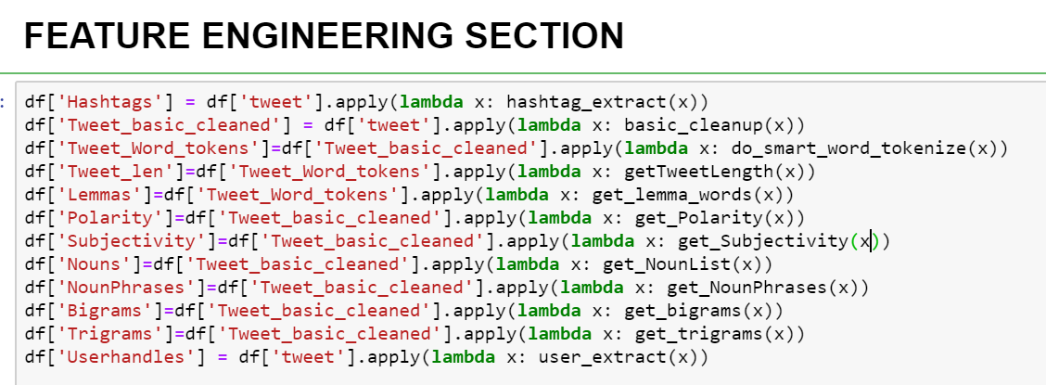
Feature Engineering

Slide 13
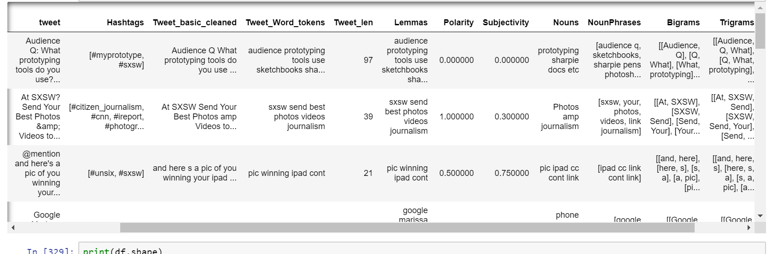
Feature Engineering 2
DATA FRAME AFTER FEATURE ENGINEERING

Slide 14
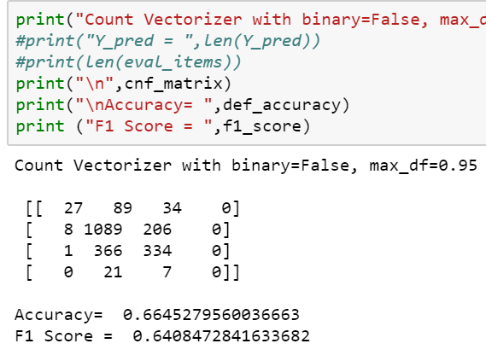
Models and Approaches
Pipeline of Vectorizers and Classifiers
Bag of words with Count Vectorizer and Logistic Regression

Slide 15
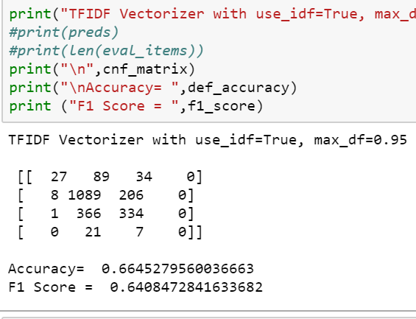
Models and Approaches
Bag of words with TFIDF Vectorizer and Logistic Regression

Slide 16
Models Tuning
Hyper parameter tuning of models
Count Vectorizer n-gram range
cv3= CountVectorizer(binary=False, ngram_range=(1,2), max_df=0.95)
cv3= CountVectorizer(binary=False, ngram_range=(2,2), max_df=0.95)

Slide 17
Evaluation and Results
Of the multiple combinations that were evaluated,
We found the best results with
COUNT VECTORIZER combined with Logistic Regression as a classifier
With ACCURACY OF 0.66
And F1 Score of 0.64
Hence we used this model for predicting the final values

Slide 18
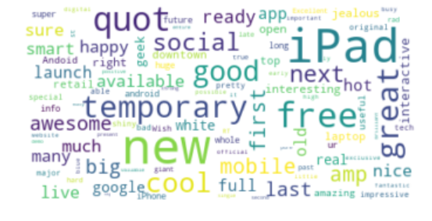
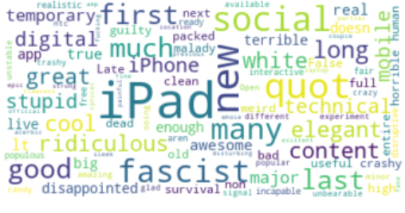
Findings and Observations
Most positive sentiments were associated with :
Most negative sentiments were associated with:

Slide 19
Findings and Observations
Most positive sentiments were associated with :
Most negative sentiments were associated with:
Product / EVENT | Words
IPAD, IPHONE, APPLE, SXSW | GOOD, GREAT, COOL, LIKE, SHINY,BUY, AWESOME, LOVE, ENVY, NICE, EXPERTS
ANDROID, GOOGLE | COOL, FREE, PARTY
Product / EVENT | Words
NETFLIX | MISTAKE
GOOGLE | LOST, INCAPABLE
IPAD, IPHONE | TOUGH, QUEUE, CHOKES
APPLE | LINE, FASCIST

Slide 20
Insights and recommendations
The combination of Apple launch products at SXSW events seems to evoke positive sentiments from youth
Positive sentiments for google products were typically with the ‘easy to use’ and ‘free’ aspects of its products like Android. This suggests that their user base may be price sensitive
Negative sentiments for Apple events seem to be around the aspect of long lines and wait times. It might help if they could add more centers at product launches
“White” as a word appeared in a few negative sentiments for apple so it suggests that they could consider other color options
SXSW as an event appears to draw a lot of young crowd who are keen on both technology and music rendered through technology. So new product launches of this kind (e.g. SAAVN or JIO MUSIC) that target a young audience could consider this as an option

